Slide 1

RADV Risk Adjustment Data Validation Tool
FHIRed UP
Augusto Burgos aburgos3@gatech.edu Spiro Ganas spiroganas@gmail.com Anja Guillory anjag1993@gmail.com Jamie Richgels jrichgels3@gatech.edu Daniel Stoneburner dstoneburner3@gatech.edu Tala Suidan tmsuidan@gatech.edu
Notes:
This presentation describes RADV, the Risk Adjustment Data Validation tool developed by team FHIRed Up.

Slide 2
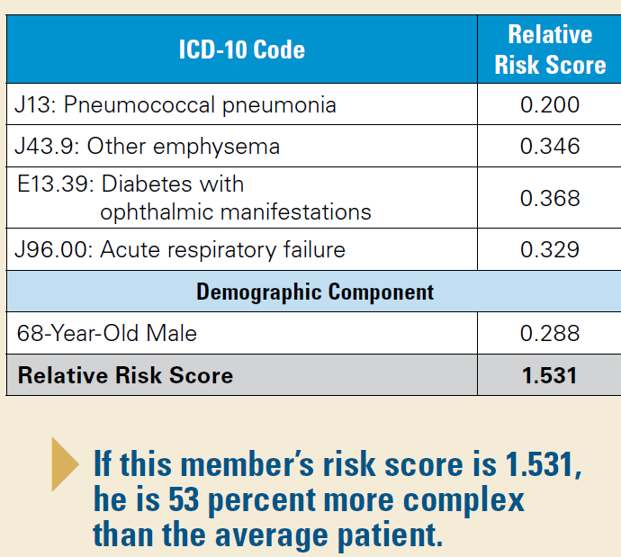
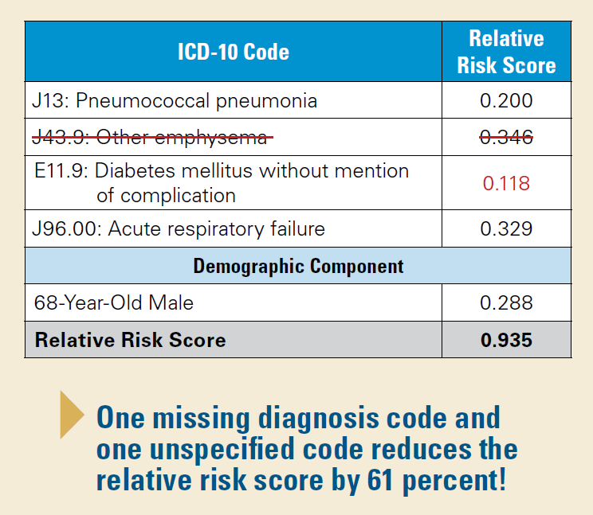
Executive Summary
Under ACA Risk Adjustment, missing or inaccurate data leads to lower provider reimbursement.
Source: https://www.bcbsal.org/providers/pdfs/riskAdjustment.pdf
Notes:
The Affordable Care Act requires health insurance companies to offer insurance to people with pre-existing conditions. By only offering policies with high co-pays and high-deductibles, insurance companies can discourage ill patients from purchasing their products. Risk adjustment prevents this by transferring premiums from insurers with healthy members to those organizations that are insuring for a more ill population.
Risk scores are use to determine the average level of illness in an insurers population. A risk score is calculated using the list of diagnoses recorded for a patient during the previous calendar year. This gives providers and insurers a strong financial interest in making medical records accurate and complete.
The RADV tool was designed to help providers validate medical records, by identifying health care conditions that may be missing from a patients recent medical record.

Slide 3
Team Member Key Responsibilities
Augusto Burgos – Co-Lead Developer
Spiro Ganas – Project Sponsor / Developer
Anja Guillory – Co-Lead Developer
Jamie Richgels – UI testing and Business Analyst
Daniel Stoneburner – Code testing
Tala Suidan – Project Manager / Business Analyst

Slide 4
Updated Gantt Chart
* All team members involved † - Developers and testers involved ‡ - Business Analysts involved
All items are complete.

Slide 5
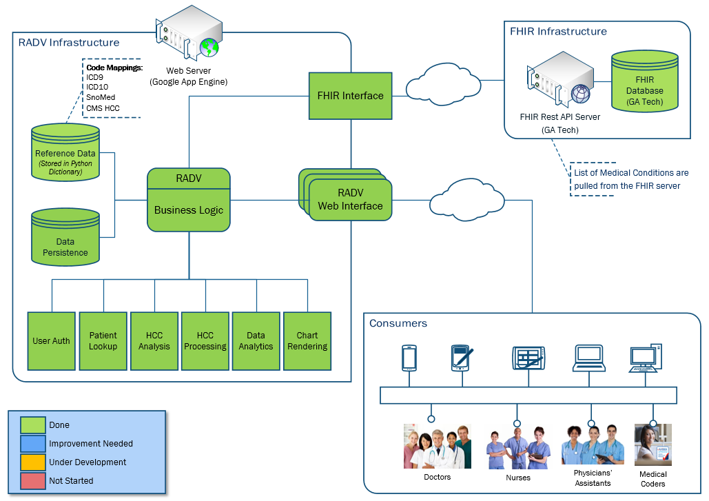
Updated RADV Architecture
Notes:
The RADV architecture consists of an interface to an external FHIR Server, a web interface for end-users and several internal modules, including Patient Lookup, HCC Analysis & Processing, Data Analytics, and Chart Rendering.
The architecture also consists of various internal data stores used for caching, code mappings (such as HCC, ICD9, SnoMed and other mappings) and persisting patient data that the FHIR server does not currently allow external applications to update.
The RADV application was developed in Python and is currently hosted on Google App Engine.

Slide 6
RADV Application Walk-Through

Slide 9
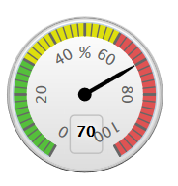

Candidate Risk Score Meter
Formula:
$$x\% =\left(1−\frac{Current Risk Score}{Sum \left(Candidate HCC Risk Scores\right)+Current Risk Score}\right)∗100\%$$
Example:
Given:
Current Risk Score: 0.723
Sum of Candidate Risk Scores:1.687
Results:
Risk Score Meter: 70
$$70\% =\left(1−\frac{0.723}{1.687+0.723}\right)∗100\%$$
Notes:
The candidate risk score meter (or gauge) is used to indicate the severity of the patient’s candidate risk score relative to their current risk score. It is used to quickly identify if the candidate HCCs would make a significant impact to the patient’s risk score, were they to be added to the patient.
Example:
If a patient has a Current Risk Score of 0.723 and the sum of their Candidate Risk Scores totals1.687, the candidate risk score meter would register 70, indicating the patient’s current risk score is 70% less then what it would be if the candidate HCCs where included.

Slide 10
QA Testing

Slide 11
Final Version of the RADV Tool
https://focus-appliance-122323.appspot.com/login
Login: FHIRedUp
Password: PjV7kGTD
Notes:
This final slide shows the web address of the RADV tool. You can use this username and password to view the final version of the software.

Slide 12
Project Post-Mortem

